Slide 1
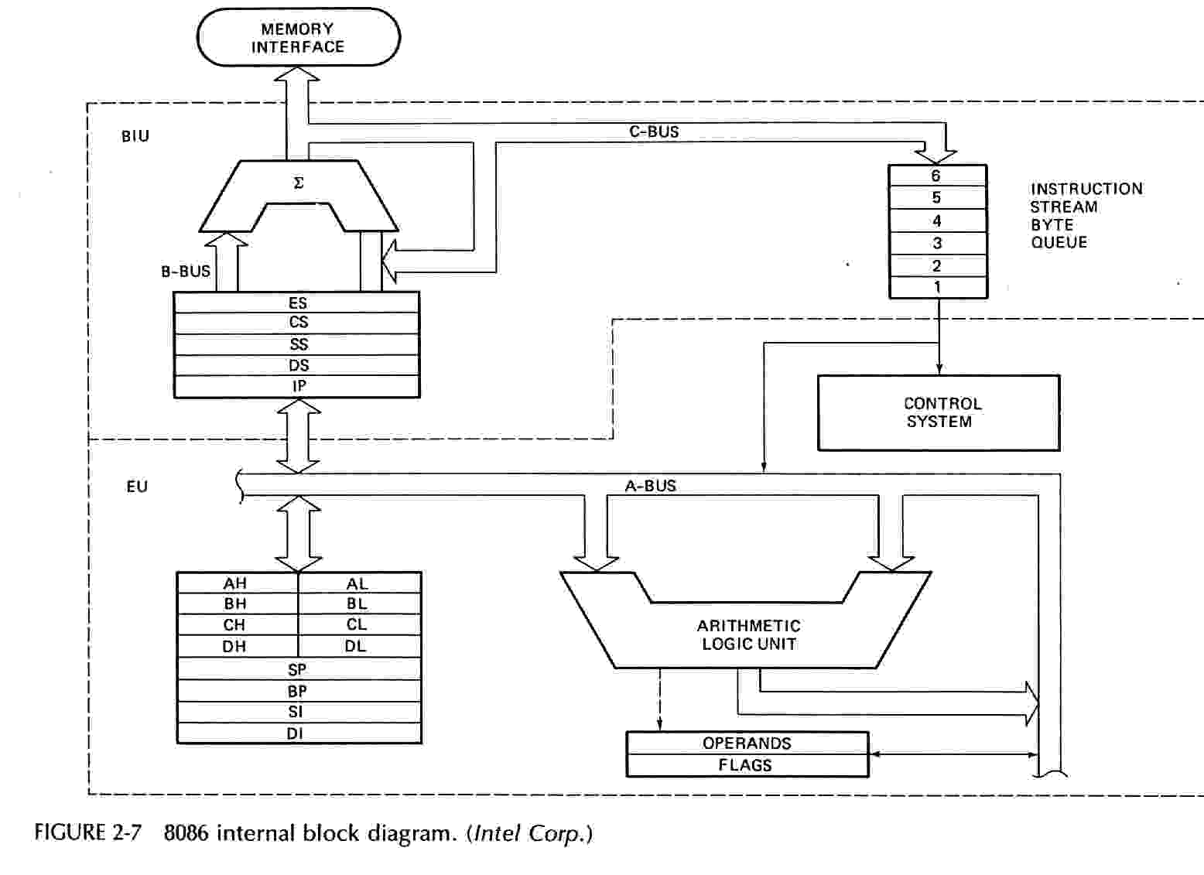
Block diagram of 8086

Slide 2
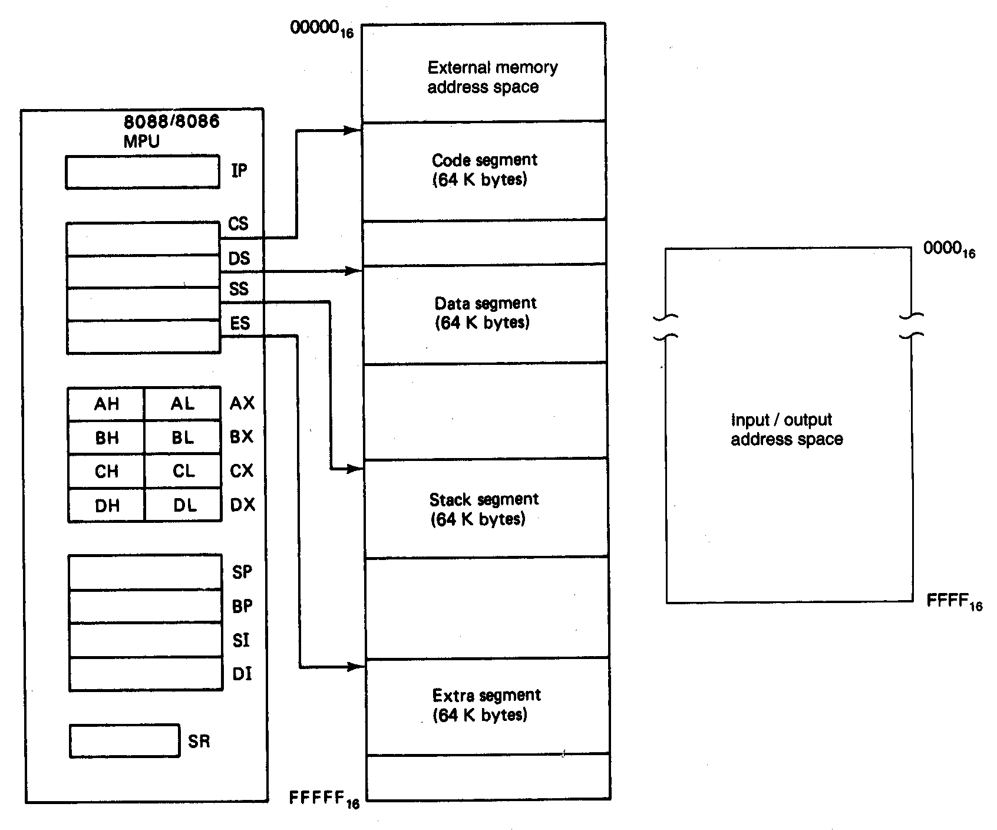
Software Model of the 8086 Microprocessors

Slide 3
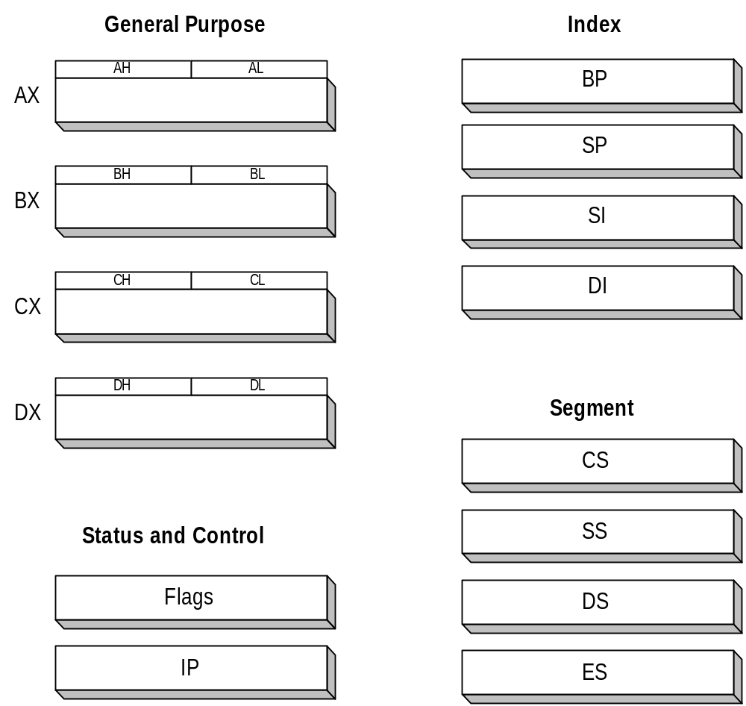
8086 Registers

Slide 4
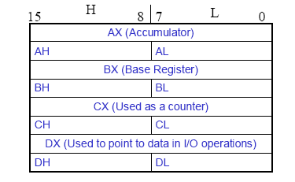
General Purpose Registers
        AX - the Accumulator
        BX - the Base Register
        CX - the Count Register
        DX - the Data Register
Normally used for storing temporary results
Each of the registers is 16 bits wide (AX, BX, CX, DX)
Can be accessed as either 16 or 8 bits AX, AH, AL

Slide 5
General Purpose Registers
AX
  Accumulator Register
  Preferred register to use in arithmetic, logic and data transfer instructions because it generates the shortest Machine Language Code
  Must be used in multiplication and division operations
  Must also be used in I/O operations
BX
  Base Register
  Also serves as an address register

Slide 6
General Purpose Registers
CX
  Count register
  Used as a loop counter
  Used in shift and rotate operations
DX
  Data register
  Used in multiplication and division
  Also used in I/O operations

Slide 7
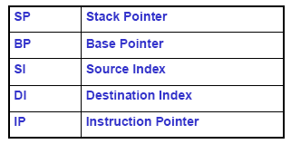
Pointer and Index Registers
All 16 bits wide, L/H bytes are not accessible
Used as memory pointers
  Example: MOV AH, [SI]
    Move the byte stored in memory location whose address is contained in register SI to register AH
IP is not under direct control of the programmer

Slide 8
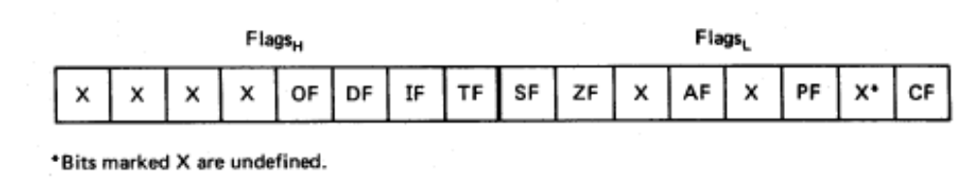
Flag Register
Overflow
Carry
Direction
Parity
Interrupt enable
Auxiliary Carry
Trap
Zero
6 are status flags
3 are control flag
Sign

Slide 9
8086 Programmer’s Model
ES
Extra Segment
_{BIU registers}
_{(20 bit adder)}
CS
Code Segment
SS
Stack Segment
DS
Data Segment
IP
Instruction Pointer
_{EU registers}
AX
AH
AL
Accumulator
BX
BH
BL
Base Register
CX
CH
CL
Count Register
DX
DH
DL
Data Register
SP
Stack Pointer
BP
Base Pointer
SI
Source Index Register
DI
Destination Index Register
FLAGS

Slide 10
The Stack
The stack is used for temporary storage of information such as data or addresses.
When a CALL is executed, the 8086 automatically PUSHes the current value of CS and IP onto the stack.
Other registers can also be pushed
Before return from the subroutine, POP instructions can be used to pop values back from the stack into the corresponding registers.

Slide 11
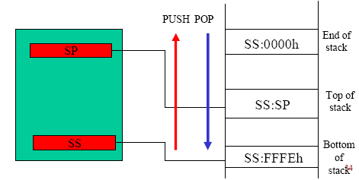
The Stack

Slide 12
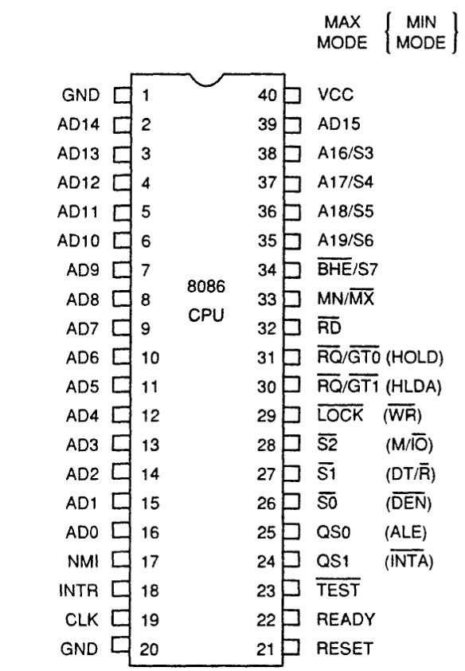
INTEL 8086 - Pin Diagram

Slide 13
INTEL 8086 - Pin Details
Power Supply
5V ± 10%
Ground
Reset
Registers, seg regs, flags
CS: FFFFH, IP: 0000H
If high for minimum 4 clks
Clock
Duty cycle: 33%

Slide 14
INTEL 8086 - Pin Details
Address/Data Bus:
Contains address bits A₁₅-A₀ when ALE is 1 & data bits D₁₅ – D₀ when ALE is 0.
Address Latch Enable:
When high, multiplexed address/data bus contains address information.

Slide 15
INTEL 8086 - Pin Details
INTERRUPT
Non - maskable interrupt
Interrupt acknowledge
Interrupt request

Slide 16
INTEL 8086 - Pin Details
Direct Memory Access
Hold
Hold acknowledge

Slide 17
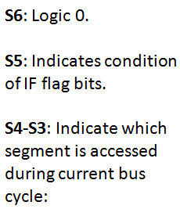
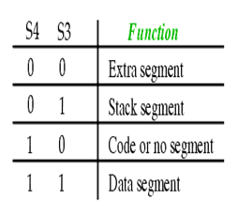
INTEL 8086 - Pin Details
Address/Status Bus
Address bits A₁₉ – A₁₆ & Status bits S₆ – S₃

Slide 18
INTEL 8086 - Pin Details
BHE#, A₀:
0,0: Whole word (16-bits)
0,1: High byte to/from odd address
1,0: Low byte to/from even address
1,1: No selection
Bus High Enable/S7
Enables most significant data bits D₁₅ – D₈ during read or write operation.
S₇: Always 1.

Slide 19
INTEL 8086 - Pin Details
Min/Max mode
Minimum Mode: +5V
Maximum Mode: 0V
Minimum Mode Pins
Maximum Mode Pins

Slide 20
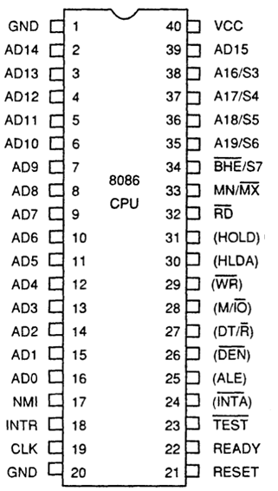
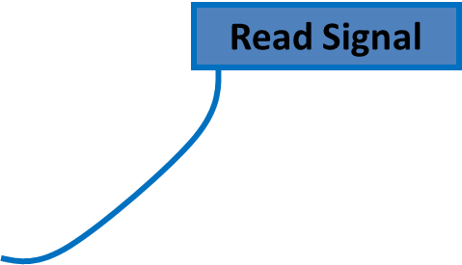




Minimum Mode- Pin Details

Slide 21
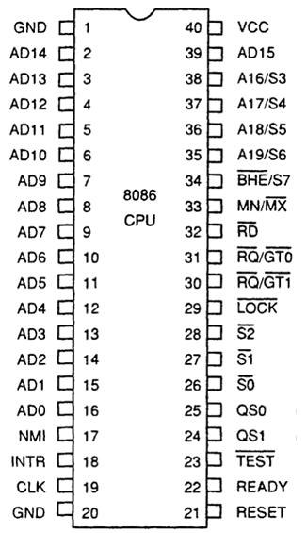
Maximum Mode - Pin Details
S2 S1 S0
000: INTA
001: read I/O port
010: write I/O port
011: halt
100: code access
101: read memory
110: write memory
111: none -passive
Status Signal
Inputs to 8288 to generate eliminated signals due to max mode.

Slide 22
Maximum Mode - Pin Details
Lock Output
Used to lock peripherals off the system
Activated by using the LOCK: prefix on any instruction
DMA Request/Grant
Lock Output

Slide 23
Maximum Mode - Pin Details
QS1 QS0
00: Queue is idle
01: First byte of opcode
10: Queue is empty
11: Subsequent byte of opcode
Queue Status
Used by numeric coprocessor (8087)

Slide 24
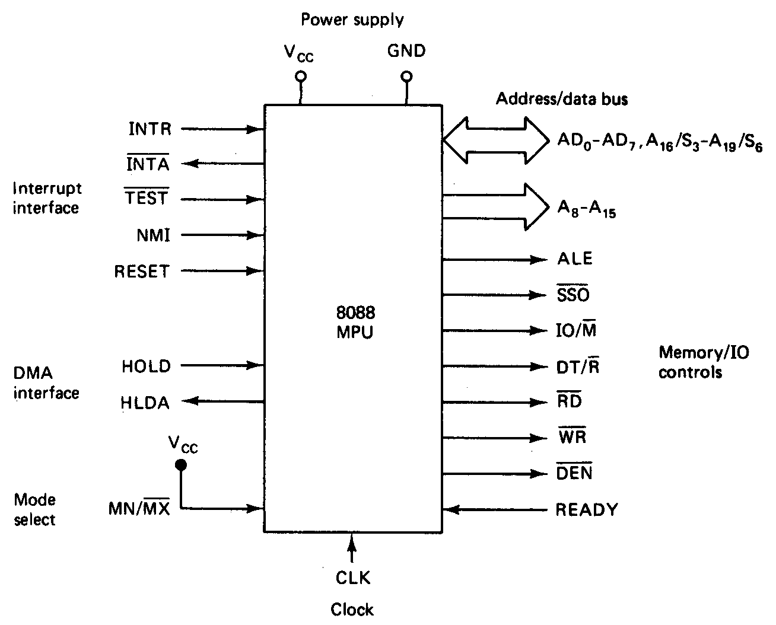
Minimum Mode 8086 System

Slide 25
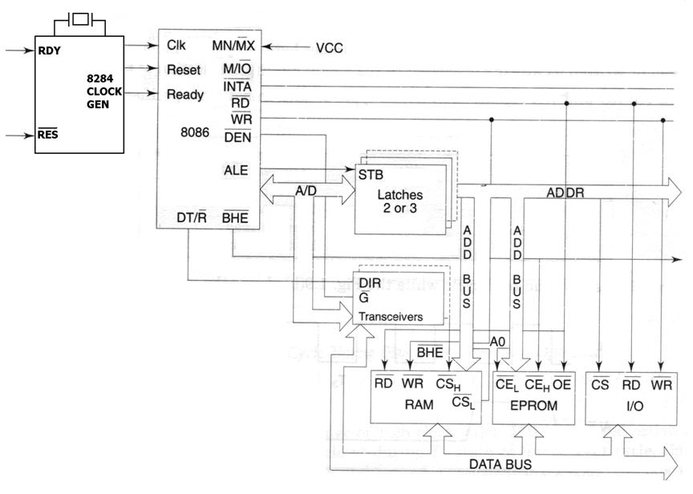
Minimum Mode 8086 System

Slide 26
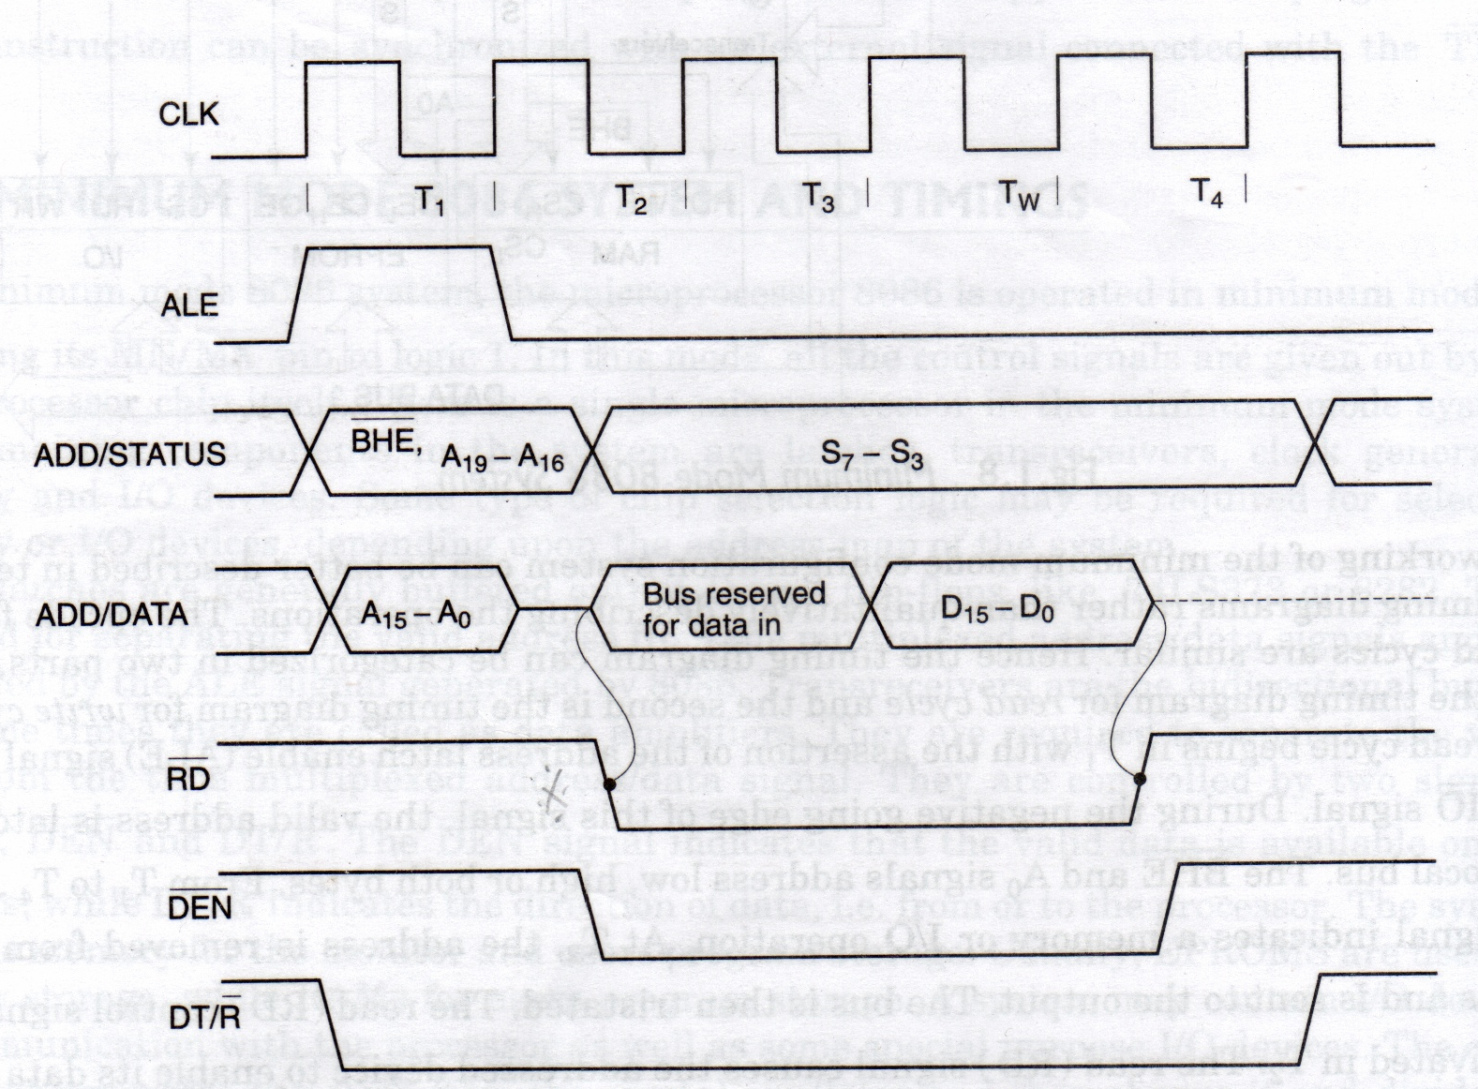
‘Read’ Cycle timing Diagram for Minimum Mode

Slide 27
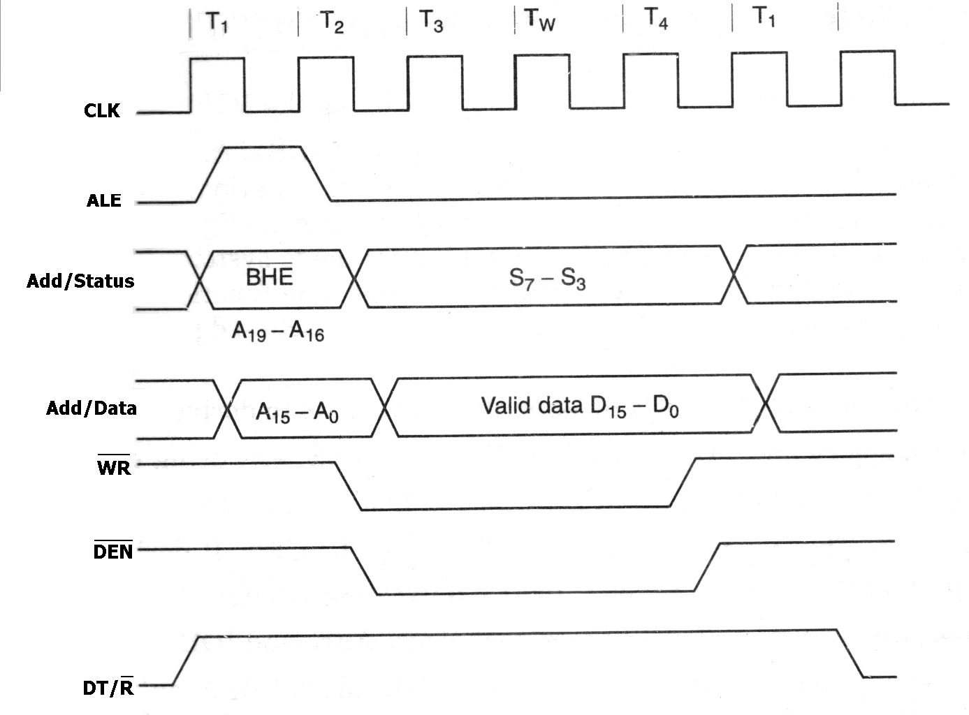
‘Write’ Cycle timing Diagram for Minimum Mode

Slide 28
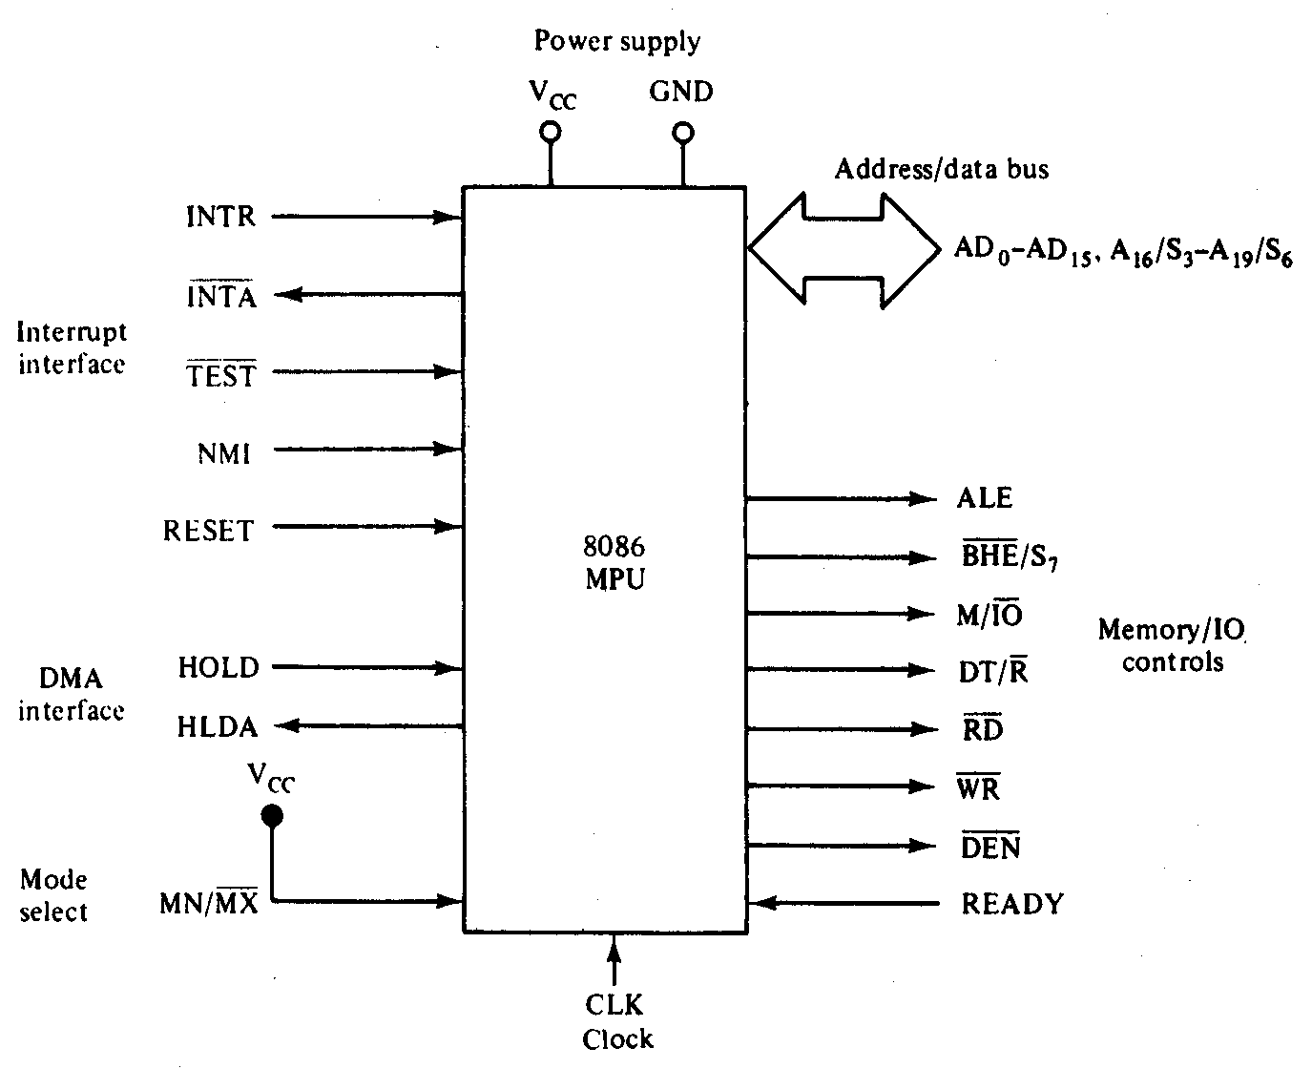
Maximum Mode 8086 System

Slide 29
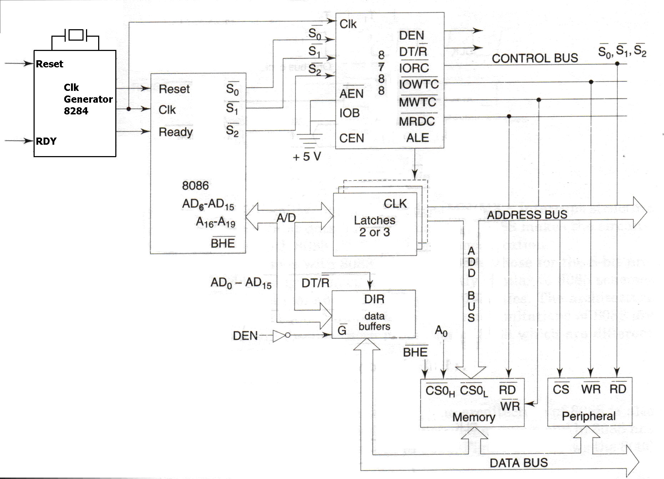
Maximum Mode 8086 System

Slide 30
Maximum Mode 8086 System
Here, either a numeric coprocessor of the type 8087 or another processor is interfaced with 8086.
The Memory, Address Bus, Data Buses are shared resources between the two processors.
The control signals for Maximum mode of operation are generated by the Bus Controller chip 8788.
The three status outputs S0*, S1*, S2* from the processor are input to 8788.
The outputs of the bus controller are the Control Signals, namely DEN, DT/R*, IORC*, IOWTC*, MWTC*, MRDC*, ALE etc.

Slide 31
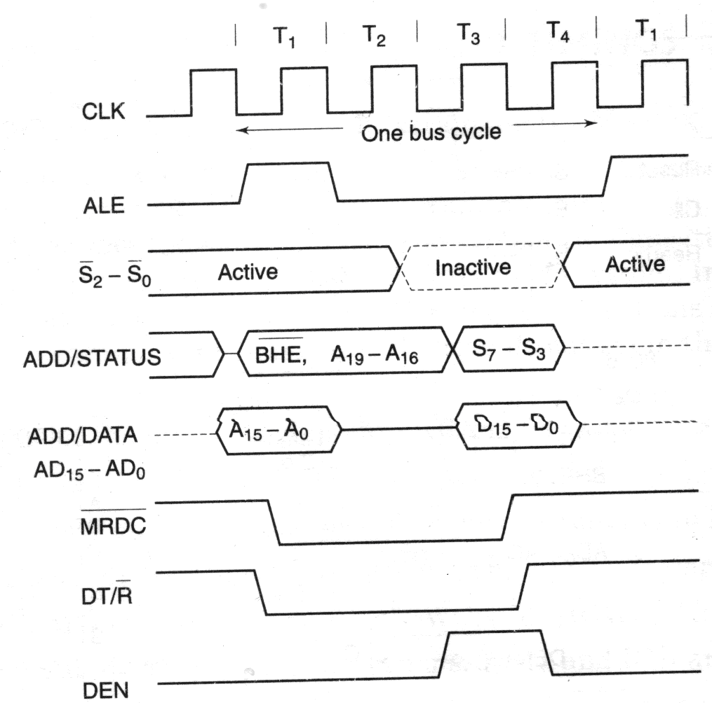
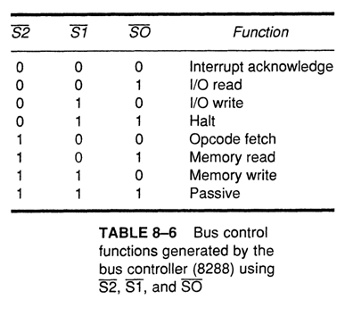
Memory Read timing in
Maximum Mode

Slide 32
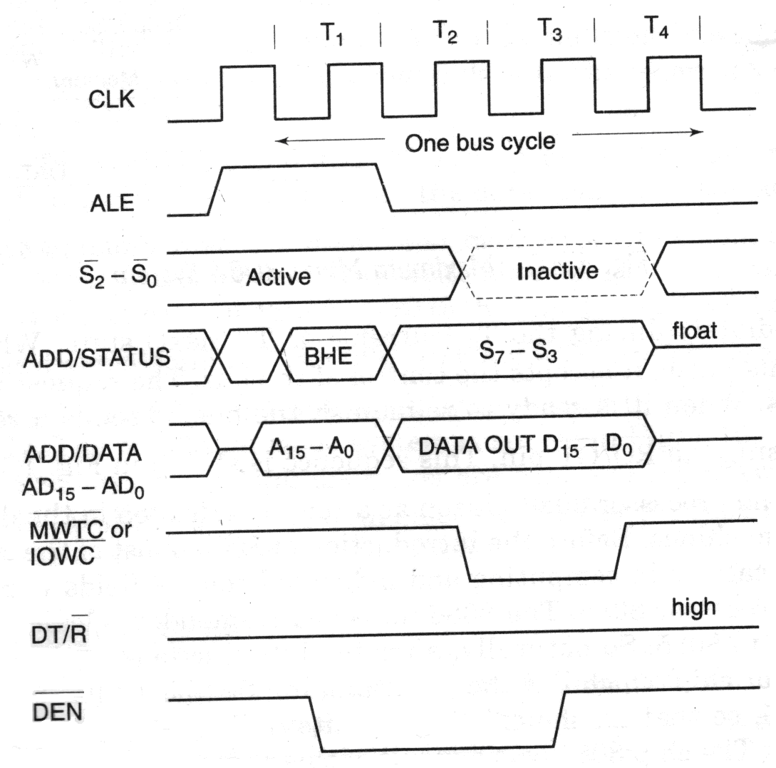
Memory Write timing in
Maximum Mode

Slide 33
8086 Control Signals
ALE
BHE
M/IO
DT/R
RD
WR
DEN

Slide 34
Coprocessor and Multiprocessor configuration
Multiprocessor Systems refer to the use of multiple processors that executes instructions simultaneously and communicate with each other using mail boxes and Semaphores.
Maximum mode of 8086 is designed to implement 3 basic multiprocessor configurations:
    1. Coprocessor (8087)
    2. Closely coupled (8089)
    3. Loosely coupled (Multibus)

Slide 35
Coprocessor and Multiprocessor configuration
Coprocessors and Closely coupled configurations are similar in that both the 8086 and the external processor shares the:
- Memory
- I/O system
- Bus & bus control logic
- Clock generator

Slide 36
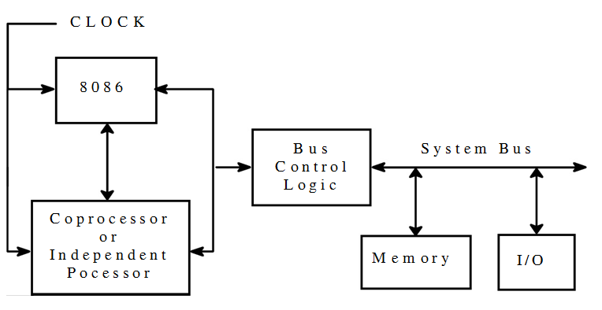
Coprocessor / Closely Coupled Configuration

Slide 37
TEST pin of 8086
Used in conjunction with the WAIT instruction in multiprocessing environments.
This is input from the 8087 coprocessor.
During execution of a wait instruction, the CPU checks this signal.
If it is low, execution of the signal will continue; if not, it will stop executing.

Slide 38
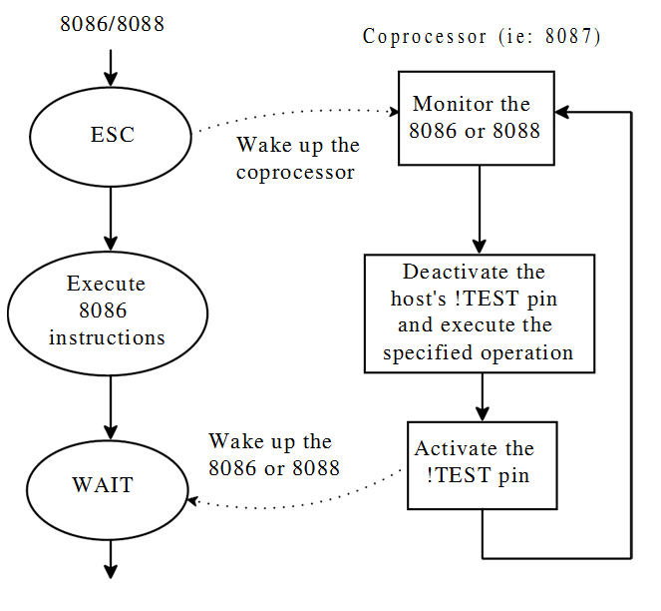
Coprocessor Execution Example
Coprocessor cannot take control of the bus, it does everything through the CPU

Slide 39
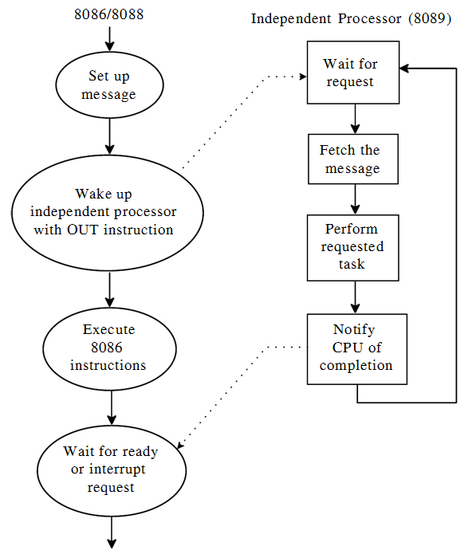
Closely Coupled Execution Example
Closely Coupled processor may take control of the bus independently.
Two 8086’s cannot be closely coupled.

Slide 40
Loosely Coupled Configuration
has shared system bus, system memory, and system I/O.
each processor has its own clock as well as its own memory (in addition to access to the system resources).
Used for medium to large multiprocessor systems.
Each module is capable of being the bus master.
Any module could be a processor capable of being a bus master, a coprocessor configuration or a closely coupled configuration.

Slide 41
Loosely Coupled Configuration
No direct connections between the modules.
Each share the system bus and communicate through shared resources.
Processor in their separate modules can simultaneously access their private subsystems through their local busses, and perform their local data references and instruction fetches independently. This results in improved degree of concurrent processing.
Excellent for real time applications, as separate modules can be assigned specialized tasks

Slide 42
Advantages of Multiprocessor Configuration
High system throughput can be achieved by having more than one CPU.
The system can be expanded in modular form.
  Each bus master module is an independent unit and normally resides on a separate PC board. One can be added or removed without affecting the others in the system.
A failure in one module normally does not affect the breakdown of the entire system and the faulty module can be easily detected and replaced
Each bus master has its own local bus to access dedicated memory or IO devices. So a greater degree of parallel processing can be achieved.

Slide 43
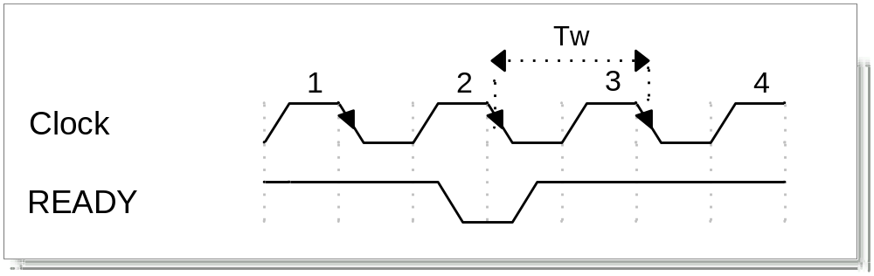
WAIT State
A wait state (T_{w}) is an extra clocking period, inserted between T2 and T3, to lengthen the bus cycle, allowing slower memory and I/O components to respond.
The READY input is sampled at the end of T2, and again, if necessary in the middle of Tw. If READY is ‘0’ then a Tw is inserted.

Slide 44
8086 System Memory Circuitry
Minimum Mode System Memory Circuitry
Maximum Mode System Memory Circuitry

Slide 45
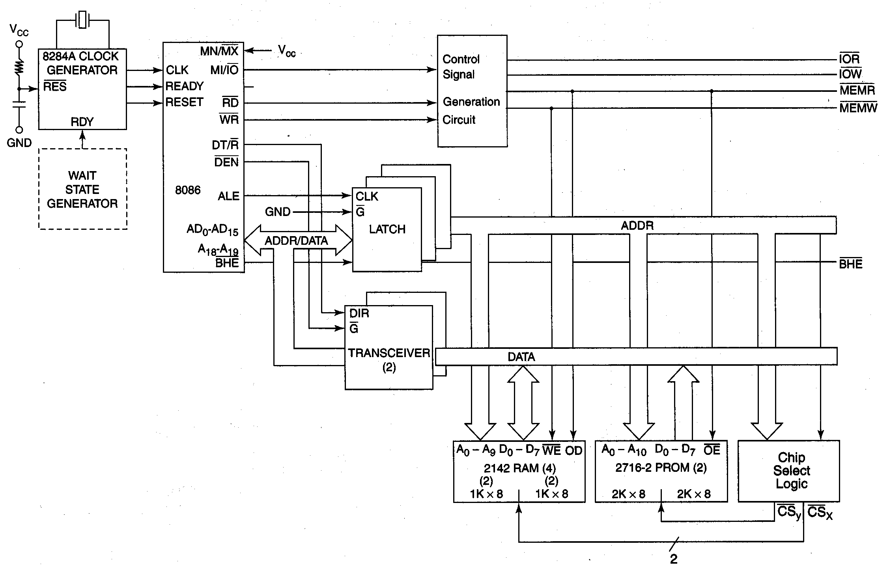
Minimum Mode System Memory Circuitry

Slide 46
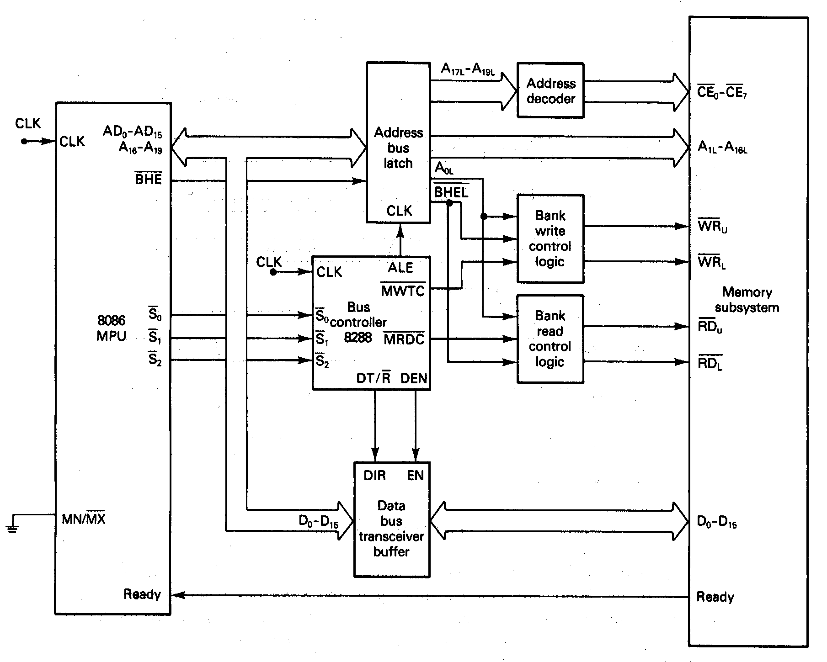
Maximum Mode System Memory Circuitry

